Slide 1
Python For Data Analytics
Akash -> 9309911897
Pranay -> 9096912594
Mahendra ->9172037674

Slide 2
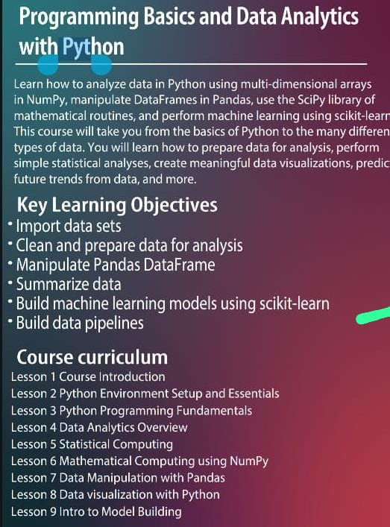
Syllabus of Python for Data Anaylytics

Slide 3
3)Python Fundamentals Syllabus
Python variable and datatypes
Python print and input function
Python operators and its types
Python decision making statement if ,if-else, nesting if-else ,ladder if-else
Python looping statement for, while and nesting loop
Python list, tuple, set, dictionary collection and its method
Python Array and python function and python recursion function
Python lambda function
Python filter and map
python Type casting
Python String and its method

Slide 4
Python Introduction
Python is a widely used general purpose, dynamic, interpreted, high level programming language developed by Guido van Rossum in 1991at the national Research institute of Mathematics and Computer Science Netherlands
It supports Object Oriented programming approach to develop applications. It is simple and easy to learn and provides lots of high-level data structures.
Python is easy to learn yet powerful and versatile(to be capable of doing many different things or being used for many different purposes) scripting language, which makes it attractive for Application Development.
Python's syntax and dynamic typing with its interpreted nature make it an ideal language for scripting and rapid application development.
Python supports multiple programming pattern, including object-oriented, imperative, and functional or procedural programming styles.

Slide 5
History Of Python
In February 1991, Guido Van Rossum published the code (labeled version 0.9.0) to alt. sources.
In 1994, Python 1.0 was released with new features like lambda, map, filter, and reduce.
Python 2.0 added new features such as list comprehensions, garbage collection systems.
On December 3, 2008, Python 3.0 (also called "Py3K") was released. It was designed to rectify the fundamental flow of the language.
ABC programming language is said to be the predecessor of Python language, which was capable of Exception Handling and interfacing with the Amoeba Operating System.

Slide 6
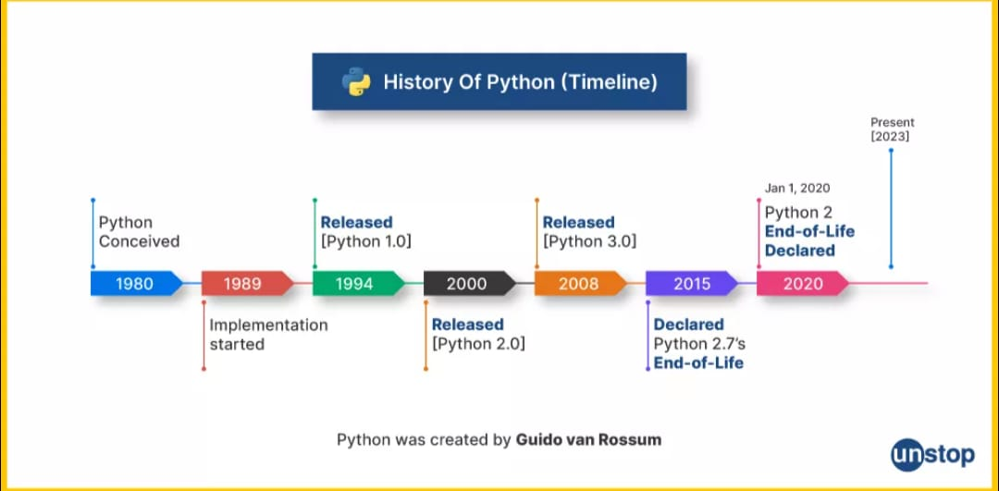

Slide 7
Why the Name Python?
There is a fact behind choosing the name Python. Guido van Rossum was reading the script of a popular BBC comedy series "Monty Python's Flying Circus".
It was late on-air 1970s.
Van Rossum wanted to select a name which unique, sort, and little-bit mysterious.
So he decided to select naming Python after the "Monty Python's Flying Circus" for their newly created programming language.
The comedy series was creative and well random.
It talks about everything. Thus it is slow and unpredictable, which made it very interesting.
Python is also versatile and widely used in every technical field, such as Machine Learning, Artificial Intelligence, Data Analytics, Web Development, Mobile Application, Desktop Application, Scientific Calculation, etc.

Slide 8
Features of Python
Simple and Easy To Learn
Python is easy to learn as compared to other programming languages. Its syntax is straightforward and much the same as the English language. There is no use of the semicolon or curly-bracket, the indentation defines the code block.
Expressive Language
Python can perform complex tasks using a few lines of code. A simple example, the hello world program you simply type print("Hello World"). It will take only one line to execute, while Java or C takes multiple lines.
Interpreted language
Python is an interpreted language; it means the Python program is executed one line at a time. The advantage of being interpreted language, it makes debugging easy and portable.
Cross platform Language
Python can run equally on different platforms such as Windows, Linux, UNIX, and Macintosh. So, we can say that Python is a portable language. It enables programmers to develop the software for several competing platforms by writing a program only once.

Slide 9
Free and Open Source
Python is freely available for everyone. It is freely available on its official website www.python.org. It has a large community across the world that is dedicatedly working towards make new python modules and functions. Anyone can contribute to the Python community. The open-source means, "Anyone can download its source code without paying any penny."
Object Oriented Programming Language
Python supports object-oriented language and concepts of classes and objects come into existence. It supports inheritance, polymorphism, and encapsulation, etc. The object-oriented procedure helps to programmer to write reusable code and develop applications in less code.
Large Standard Library
It provides a vast range of libraries for the various fields such as machine learning, web developer, and also for the scripting. There are various machine learning libraries, such as Tensor flow, Pandas, Numpy, Keras, and Pytorch, etc. Django, flask, pyramids are the popular framework for Python web development.
Gui Programming Supports
Graphical User Interface is used for the developing Desktop application. PyQT5, Tkinter, Kivy are the libraries which are used for developing the web application.

Slide 10
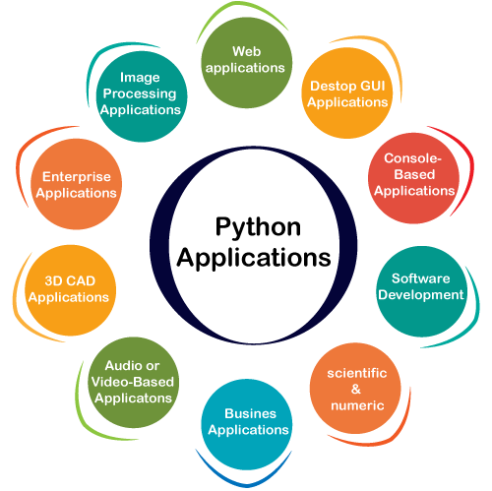
Python Applications

Slide 11
Web applications :www.youtube.com , www.Linkedin.com
Desktop Gui Application :- Notepad, word, Pycharm
Console application : only character based application
Software Development : ERP Application, Billing application
Audio And Video Based Application: Cliphamp, iMovie, DanVinci Resolve.
Business Application : flipkart, amazon
Image Processing Application: X-rays and MRI Scanner.
Scientific application: Brainly, Rstudio, Zotero,Wikipedia
Cad Application : Cad /Com Application
Enterprise application :SAP/HANA Net Suite, HubSpot,Salesforce

Slide 12
Careers With Python

Slide 13
Installation of Python
There are many interpreters available freely to run Python scripts like IDLE (Integrated Development Environment) which is installed when you install the python software from
Link For Download Python in Your Pc/laptop: http://python.org/downloads/
Steps to be followed and remembered:
Step 1: Select Version of Python to Install.
Step 2: Download Python Executable Installer.
Step 3: Run Executable Installer.
Step 4: Verify Python Was Installed On Windows.
  Open the command prompt and run the following command:
python --version

Slide 14
Execution Process of Python
Python Code Execution:
Python’s traditional runtime execution model: Source code you type is translated to byte code, which is then run by the Python Virtual Machine (PVM). Your code is automatically compiled, but then it is interpreted.
            Source Byte Runtime
            Code Code
            What is Source Code
            Source Code is Code which is written by the programmer in human readable form with proper programming language.
            What is Byte Code
            ByteCode is the intermediate code generated by the Python compiler . Bytecode is run by interpreter pvm instead of the original machine (Computer processor). This code is platform-independent
m.py
m.pyc
PVM

Slide 15
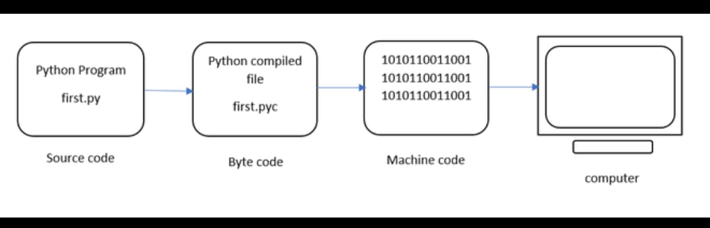
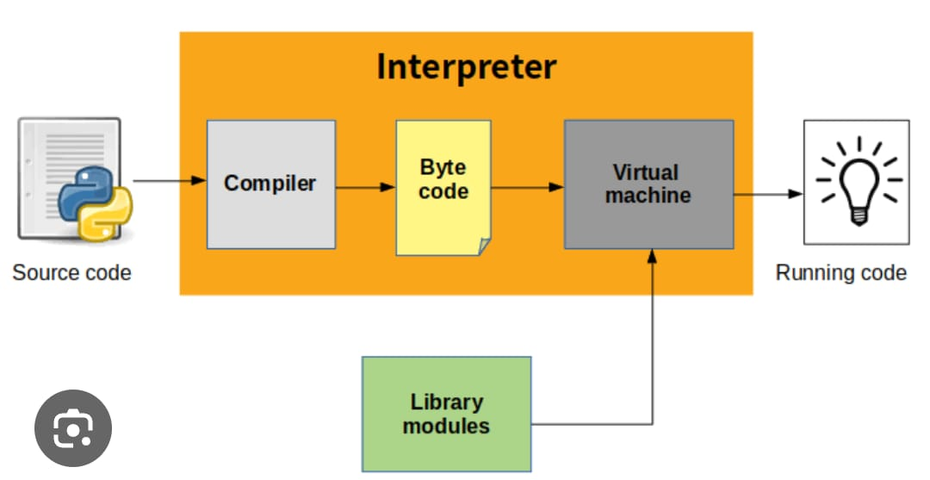
Execution Process of Python

Slide 16
Difference between compiler and interpreter
S.No | Interpreter | Compiler
1 | It interprets line by line and executes | Whole program at a time
2 | It gives the result line by line | It gives whole output at a time
3 | If any error occurs interpreter stops Hence it shows only one error | It checks all statements in the program and shows all the errors in the program.
4 | It will not generate executable file | If no errors in the program, then it generates executable file
5 | It always executes only source code | It executes exe file
6 | all scripting languages | all programming language
7 | Eg: HTML, PERL, Java Script, Python, Shell | Eg; C, C++ ,java and .Net C#
8 | Interpreter based languages don’t have exe file concept | Every program converts into exe file
9 | Open Source, it can be modified any time | It is not an open source , it is exe based , it’s code can not be modified

Slide 17
Automatic Compilation in Python
Python is an interpreted language, but it also goes through a compilation step automatically
Your .py file (source code) is first compiled into bytecode.
The bytecode is a lower-level, platform-independent representation of your code.
This bytecode is then sent to the Python interpreter (Python Virtual Machine - PVM), which executes it line by line.
Why Is It Automatic?
Python hides the compilation step from the user to simplify the development process.
Unlike languages like C or Java (where you explicitly compile), Python handles it in the background.
This improves developer productivity and allows for quicker testing and iteration.
When you run a Python script, it may create a .pyc file inside the __pycache__ folder.
This is the compiled bytecode version of your script, used to speed up future runs.

Slide 18
Install or download Jupyter Notebook
>pip --version
Using PIP with Python is one of the best method to install Jupyter Notebook in your Windows Operating System
Step 1: Check for any Exisiting Update
Use the following command to update pip (to verify if pip is updated):
python -m pip install --upgrade pip
Step 2: Install Jupyter Notebook
After updating the pip version, type the following command to install Jupyter:
python -m pip install jupyter
Step 3: Launching Jupyter
Use the following command to launch Jupyter using:
jupyter notebook

Slide 19
Jupyter Notebook
Interactive Environment: Jupyter Notebook provides an interactive web-based environment where you can write and run code, visualize data, and document your work all in one place.
Supports Multiple Languages: Although primarily used for Python, Jupyter also supports many other programming languages via kernels (e.g., R, Julia, Scala).
Code and Text in One Document: You can combine executable code, rich text (using Markdown), equations (using LaTeX), and visualizations in a single document.
Open Source: Jupyter Notebook is open-source and freely available, making it accessible to anyone.
Widely Used in Data Science: It's a popular tool among data scientists and researchers for data analysis, machine learning, and statistical modeling.

Slide 20
Jupyter Notebook
Cell-Based Execution: Notebooks are made up of cells that can be executed independently, allowing easy debugging and iterative development.
Integration with Other Tools: Can be run on local machines or cloud platforms like Google Colab, Binder, or JupyterHub for collaborative work.
Extensions and Customization: Jupyter supports a wide variety of extensions and themes that enhance functionality (e.g., spell checker, table of contents, code folding).

Slide 21
Python print() function
The print() function in Python is a built-in function used to display output on the screen (console).
It sends the specified message, variable, or expression result to the standard output (usually the terminal).
Syntax of print() function --
print(object1, object2, ..., sep=' ', end='\n')
Parameter | Description
object(s) | The values you want to print. Can be strings, numbers, variables, etc.
sep | (Optional) Separator between objects. Default is a space ' '.
end | (Optional) What to print at the end. Default is newline \n.

Slide 22
Python print() function
print("Hello, World!")
print("Name:", "Alice", "Age:", 25) //Printing multiple items:
print("2025", "07", "02", sep="-") # Output: 2025-07-02
print("Hello", end=" ")
print("World!") # Output: Hello World!

Slide 23
Python Variables and There Rules
A variable in Python is a named location in memory used to store data that can be changed during program execution.
It acts as a label for a value, allowing you to reference and manipulate the value throughout your code.
Rules of Declaring Variables in Python
  Variable names must start with a letter (A–Z or a–z) or an underscore (_)
Example: name, _value
  Cannot start with a number
    ❌ Invalid: 1name ✅ Valid: name1
  Can include letters, numbers, and underscores
    Example: user_name1, temp_123
  Cannot use special characters like @, #, $, %, etc.
  ❌ Cannot use Python reserved keywords (e.g., if, for, while, class, def)
  Case-sensitive
    name and Name are two different variables.
  No need to declare type explicitly
    Python is dynamically typed, so the type is inferred from the value.
python
a = 5 # int b = "Hi" # str

Slide 24
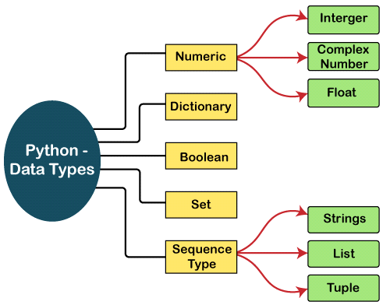
Python Datatypes

Slide 25
Python Datatypes complex_number = real_part + imaginary_part * j j represents the imaginary unit (just like i in mathematics).
Python uses j instead of i for complex numbers.
Feature | int (Integer) | float (Floating Point) | complex (Complex Number) | str (String)
Definition | Whole numbers | Numbers with decimals | Numbers with real & imag parts | Sequence of characters
Example Values | 5, -10, 0, 999 | 3.14, -0.5, 2.0 | 2+3j, -1-1j, 5j | "hello", 'Python'
Decimal Support | No | Yes | Yes (real and imaginary) | Not numeric
Imaginary Part | Not supported | Not supported | Yes (with j) | Not applicable
Type Name | int | float | complex | str
Conversion Example | int(3.9) → 3 | float(5) → 5.0 | complex(2, 3) → 2+3j | str(100) → "100"
Supports Math Ops | Yes | Yes | Yes | (only string operations)
Use Case | Counting, indexing | Measurements, averages | Scientific/engineering | Text processing

Slide 26
Python Keywords
Python keywords are unique words reserved with defined meanings and functions that we can only apply for those functions. You'll never need to import any keyword into your program because they're permanently present. There Are 35+ Keywords in Python
False | await | else | import | pass
None | break | except | in | raise
True | class | finally | is | return
and | continue | for | lambda | try
as | def | from | nonlocal | while
assert | del | global | not | with
async | elif | if | or | yield

Slide 27
Python Input() function
input() is a built-in function used to take input from the user via the keyboard.
It returns the input as a string, regardless of what the user types.
name = input("Enter your name: ")
age=int(input("Enter your age: "))
print(name) # Always a string
input() is different from raw_input() in Python 2. In Python 3, only input() exists and behaves like raw_input() did.

Slide 28
Python Indentation
Indentation in Python refers to the spaces or tabs added at the beginning of a line to indicate a block of code.
Unlike many other programming languages that use curly braces {} to group code blocks, Python uses indentation as a core part of its syntax.
✅ Indentation defines code blocks
In Python, blocks of code for functions, loops, conditionals, and classes are defined by indentation — not by braces. if x > 0: print("Positive number")
❌ Improper indentation causes errors
If indentation is missing or inconsistent, Python raises an IndentationError or misinterprets the code logic.
if x > 0: print("Error!") # Incorrect indentation
✅ Standard indentation is 4 spaces
Python's official style guide (PEP 8) recommends using 4 spaces per indentation level for consistency and readability.
🚫 Do not mix tabs and spaces
Mixing tabs and spaces in the same file or block can cause errors and unexpected behavior. Always use only spaces.
✅ Essential for readability and logic
Proper indentation makes Python code clean, structured, and easy to understand. It's both a stylistic and functional requirement.

Slide 29
Python Operators
The operator is a symbol that performs a certain operation between two operands, according to one definition. In a particular programming language, operators serve as the foundation upon which logic is constructed in a programme. The different operators that Python offers are listed here.
Arithmetic operators
Comparison operators/Relational Operators
Assignment Operators
Logical Operators
Membership Operators
Identity Operators

Slide 30
Arithmetic operators
Arithmetic operations between two operands are carried out using arithmetic operators. It includes the exponent (**) operator as well as the + (addition), - (subtraction), * (multiplication), / (divide), % (reminder), and // (floor division) operators.
These operators are used to perform basic mathematical operations such as addition, subtraction, multiplication, division, and modulus.
Operator | Description | Example | Use (Result)
+ | Addition | 5 + 3 | Adds values (Result: 8)
- | Subtraction | 5 - 3 | Subtracts values (2)
* | Multiplication | 5 * 3 | Multiplies values (15)
/ | Division | 6 / 3 | Divides values (2.0)
// | Floor Division | 7 // 2 | Division, removes decimal (3)
% | Modulus | 7 % 2 | Remainder of division (1)
** | Exponentiation | 2 ** 3 | Raises to power (8)

Slide 31
Assignment Operators
The right expression's value is assigned to the left operand using the assignment operators. The following table provides a description of the assignment operators.
These are used to assign values to variables and can also perform operations while assigning (e.g., +=, -=).
Operator | Description | Example | Use (Final value of x)
= | Assign | x = 5 | Assigns value 5 to x
+= | Add and assign | x += 2 | x = x + 2
-= | Subtract and assign | x -= 2 | x = x - 2
*= | Multiply and assign | x *= 2 | x = x * 2
/= | Divide and assign | x /= 2 | x = x / 2
//= | Floor divide and assign | x //= 2 | x = x // 2
%= | Modulus and assign | x %= 2 | x = x % 2
**= | Exponent and assign | x **= 2 | x = x ** 2

Slide 32
Comparison operators/Relational Operators
Comparison operators compare the values of the two operands and return a true or false Boolean value in accordance. The following table lists the comparison operators.
Also known as relational operators, these are used to compare two values and return a Boolean result (True or False) based on the comparison.
Operator | Description | Example | Use (Result)
== | Equal to | 5 == 5 | True if equal (True)
!= | Not equal | 5 != 3 | True if not equal (True)
> | Greater than | 5 > 3 | True if left > right (True)
< | Less than | 3 < 5 | True if left < right (True)
>= | Greater than or equal | 5 >= 5 | True if left ≥ right (True)
<= | Less than or equal | 3 <= 5 | True if left ≤ right (True)

Slide 33
Python Logical Operators
These are used to combine multiple conditional statements and return a Boolean value depending on the logic (e.g., AND, OR, NOT).
Operator | Description | Example | Use (Result)
And | Logical AND | True and False | True if both are true (False)
or | Logical OR | True or False | True if one is true (True)
not | Logical NOT | not True | Reverses condition (False)

Slide 34
Python MemberShip Operators
These test whether a value or variable is found within a sequence such as a list, tuple, or string.
Operator | Description | Example | Use (Result)
in | Present in sequence | 'a' in 'apple' | True if found (True)
not in | Not in sequence | 'x' not in 'apple' | True if not found (True)
Python Identity Operators
These check whether two variables refer to the same object in memory (not just if their values are equal).
Operator | Description | Example | Use (Result)
is | Same object identity | x is y | True if same object in memory
is not | Not same object | x is not y | True if not same object in memory

Slide 35
Python Decision Making Statements
Python decision-making statements allow the program to execute certain blocks of code based on specific conditions. These statements evaluate expressions and control the flow of execution depending on whether a condition is True or False.
Python decision-making statements are control flow constructs that allow a program to make choices and execute different blocks of code based on one or more conditions. These statements evaluate logical or relational expressions, and depending on whether the condition is true or false, specific parts of the code are executed or skipped. This enables the program to react dynamically to different inputs or states during execution, making it capable of handling real-world decision processes.
Key Keywords: Python uses if, elif, and else for decision-making.
Boolean Logic: Conditions are evaluated as Boolean expressions (True or False).
Indentation Matters: Python uses indentation (typically 4 spaces) to define the block of code under each condition.
Nested Conditions: You can nest if statements inside one another for complex logic.
Short-Circuit Evaluation: Logical operators like and and or stop evaluating as soon as the result is determined.

Slide 36
Python Decision Making Statements
Statement Type | Definition | Use | Syntax | Example Code
if Statement | Executes a block of code only if the condition is true. | Use when you want to check one condition. | if condition: # Code Block | x = 10 if x > 5: print("x is greater than 5“)
if-else Statement | Executes one block if condition is true, another if false. | Use when you have two choices or outcomes. | if condition: # true Block else:# false Block | x = 3 if x > 5: print("x is greater than 5") else: print("x is 5 or less")
if-elif-else Statement | Checks multiple conditions. First true one runs; else runs if none are true. | Use when checking three or more conditions. | if condition1: # block1 elif condition2: # block2 else: # block3 | x = 0 if x > 0: print("Positive") elif x == 0: print("Zero") else: print("Negative")
Nested if-else Statement | One if or else contains another if-else inside. | Use when decisions depend on another condition. | if condition1: if condition2: block else: # block else: # block | x = 15 if x > 10: if x < 20: print("x is between 10 and 20") else: print("x is 20 or more") else: print("x is 10 or less")

Slide 37
Assignment On Decision Making Statement
Check Even or Odd Number
Write a Python program that takes a number as input and checks whether it is even or odd using an if statement.
Find the Largest of Two Numbers
Write a program to accept two numbers from the user and use an if-else statement to print the largest number.
Check Eligibility to Vote
Write a program that asks the user to enter their age and uses if-else to determine if they are eligible to vote (age ≥ 18).
Grade Calculation Based on Marks
Write a program that takes marks (0 to 100) as input and uses if-elif-else to print the grade:
  A: 90–100
  B: 75–89
  C: 60–74
  D: 40–59
  F: below 40
Check if a Number is Positive, Negative, or Zero
Write a Python program that checks whether a given number is positive, negative, or zero using if-elif-else.

Slide 38
Check if a Character is a Vowel or Consonant
Write a program to input a character and check whether it is a vowel or consonant using if-else.
Find the Largest Among Three Numbers
Write a Python program that takes three numbers as input and uses if-elif-else to find and print the largest number.
Check Divisibility by 3 and 5
Write a program that checks whether a number is divisible by both 3 and 5 using a single if statement with logical operators.
Nested if-else: Age and Gender Check
Write a program that checks if a person is eligible for a job:
  Age must be above 18
  If age > 18, then check gender:
    If male → eligible
    If female → not eligible
    Use nested if-else statements.
Electricity Bill Calculator (Simple Slab System)
Write a program to input the number of electricity units consumed and calculate the bill using the following rules:
Up to 100 units: ₹5/unit
101–200 units: ₹7/unit
More than 200 units: ₹10/unit
Use if-elif-else to solve.

Slide 39
Python Looping Statements
A looping statement allows you to execute a block of code repeatedly based on a condition.
Looping statements are used to execute a block of code repeatedly until a specific condition is met.
Python supports two main types of loops: for loops and while loops.
The for loop is commonly used to iterate over sequences such as lists, strings, and ranges.
The while loop continues to execute as long as the given condition remains True.
Loop control statements like break, continue, and pass are used to modify the flow of loops.
Python provides two main types of loops:
for loop
while loop

Slide 40
range() Function in Python?
The range() function in Python is used to generate a sequence of numbers. It's commonly used in loops, especially for loops, to specify how many times the loop should run or what values to iterate over.
Syntax of range(1,20)
python
range(start, stop, step)
Parameter | Description | Optional/Required
start | Starting number of the sequence | Optional (default is 0)
stop | End of the sequence (not included) | Required
step | Difference between each number (default 1) | Optional
for i in range(5):
print(i)
for i in range(2, 6):
print(i)
for i in range(1, 10, 2):
print(i)
for i in range(10, 0, -2):
print(i)
Common Uses Of Range Function
range() helps generate sequences of numbers for looping.
It can be customized sing start, stop, and step.
It's efficient and commonly used in for loops.

Slide 41
Python For Loop and While loop
Feature | for Loop | while Loop
Definition | Used to iterate over a sequence (like list, tuple, string, or range). | Repeats a block of code as long as a condition is True.
Syntax | for variable in sequence: # code block | while condition: # code block
Control Type | Definite loop (number of iterations is known or defined). | Indefinite loop (number of iterations is not known in advance).
Use Case | When you want to loop through items in a collection or range. | When you want to loop until a condition changes (e.g., user input, counter).
Example | for i in range(5): print(i) | i = 0 while i < 5: print(i) i += 1
Common Uses | Iterating over: ✅ Lists ✅ Strings ✅ Ranges | Repeating actions: ✅ User input ✅ Wait loops ✅ Condition checks
Termination | Stops when sequence ends. | Stops when the condition becomes False.
Loop Control | Works well with break, continue, and else. | Same as for, supports break, continue, and else.

Slide 42
Break And Continue Statements in Python
1. break Statement
The break statement is used to exit a loop prematurely, before the loop condition becomes false or the sequence is fully iterated.
It is commonly used when a certain condition is met, and you want to stop the loop immediately.
Example (for understanding only, no code needed):
If you're searching for an item in a list, and you find it, you can use break to stop the loop at that point.
2. continue Statement
The continue statement is used to skip the current iteration of a loop and move directly to the next one.
It is used when a certain condition occurs and you want to skip processing for that particular iteration, without exiting the loop entirely.
for i in range(1, 10):
if i == 5:
break
print(i)
for i in range(1, 6):
if i == 3:
continue
print(i)

Slide 43
Python Nesting Loop
A nested loop is a loop inside another loop. In Python, this means you can place a for loop or a while loop inside another for or while loop.
Nested loops are commonly used to work with multi-dimensional data structures, like 2D lists (matrices) or tables.
for outer_var in outer_sequence:
for inner_var in inner_sequence:
# Inner loop block
...
while outer_condition:
# Outer loop block
while inner_condition:
# Inner loop block
...
i = 1
while i <= 3:
j = 1
while j <= 3:
print(f"{i},{j}", end=" ")
j += 1
print() # Move to the next line after inner loop
i += 1
for i in range(1, 4): # Outer loop
for j in range(1, 4): # Inner loop
print(f"{i},{j}", end=" ")
print() # New line after inner loop finishes

Slide 44
Ptyhon loop Practise Quesions
Write a for loop that prints numbers 1 to 10, but skips number 5 using continue.
Use a while loop to print numbers from 1 to 10. Stop the loop if the number is divisible by 7 using break.
Write a nested for loop to print a 3x3 multiplication table, skipping rows where the outer loop value is even.
Write a for loop to iterate over a list ['a', 'b', 'c', 'd'], and stop the loop if the current letter is 'c’.
Use a while loop to print numbers from 10 to 1, but skip numbers divisible by 3.
Use a nested while loop to print a rectangle of stars (3 rows × 5 stars), skipping the second row.
In a for loop from 1 to 20, print only odd numbers using continue.
Create a while loop that prints squares of numbers starting from 1. Break the loop if the square exceeds 100
Use a nested loop to print all combinations of numbers from 1 to 3 and letters from ['x', 'y'], but skip when number is 2 and letter is 'y’.
Use a for loop to iterate through a string. Stop printing characters if you hit a vowel.

Slide 45
Ptyhon loop Practise Quesions
Write a while loop that prints even numbers between 1 and 20, but stops when number reaches 16.
Create a nested loop to print all pairs (i, j) where i is 1–3 and j is 1–3, but skip pairs where i == j.
Use a for loop with continue to print numbers from 1 to 10, excluding multiples of 4.
Write a while loop to keep asking for user input until the user enters 'exit'. (Use break.)
Create a nested loop to print numbers from 1 to 3, and for each, print numbers from 1 to 2, but break the inner loop when the inner number is 2.
Use a for loop to iterate from 0 to 9. If the number is a multiple of both 2 and 3, use continue.
Use a while loop to count backwards from 10, skipping 6 and stopping at 3.
Create a for loop over a list of numbers. Print only those that are divisible by 5 using continue.
Create nested for loops to print a right-angled triangle of numbers (e.g. 1, 1 2, 1 2 3, ...) up to 5 rows.
Use a while loop to simulate a countdown. If number is 3, print "BOOM!" and break. Otherwise, print the number.

Slide 46
Python List (Collection)
Definition:
A List is an ordered, mutable collection in Python that can contain elements of different data types. Lists allow duplicate values and support indexing and slicing.
Python
example = [1, 2, 3, "hello", 4.5]
Ordered: Maintains the order of elements.
Mutable: Can be modified after creation.
Allows Duplicates: Elements can repeat.
Indexed: Accessed using indices.
Dynamic: Size can be changed during runtime

Slide 47
List Collection Methods
Method | Definition | Example
append(x) | Adds an element x to the end of the list | lst.append(10)
extend(iterable) | Adds all elements of an iterable | lst.extend([3, 4])
insert(i, x) | Inserts an element x at position i | lst.insert(1, "apple")
remove(x) | Removes first occurrence of value x | lst.remove(3)
pop([i]) | Removes and returns element at index i or last if not specified | lst.pop() or lst.pop(2)
clear() | Removes all elements | lst.clear()
index(x) | Returns the first index of x | lst.index("apple")
count(x) | Counts occurrences of x | lst.count(10)
sort() | Sorts the list in ascending order | lst.sort()
reverse() | Reverses the list | lst.reverse()
copy() | Returns a shallow copy | new_lst = lst.copy()

Slide 48
Python Tuple Collection
Definition:
A Tuple is an ordered, immutable collection of elements. Tuples support indexing, allow duplicates, and are generally used for fixed collections.
Python
example = (1, 2, 3, "hello", 4.5)
Ordered: Maintains insertion order.
Immutable: Cannot be changed after creation.
Allows Duplicates: Can store repeating values.
Indexed: Elements can be accessed via indices.
Efficient: Faster and consumes less memory than lists.

Slide 49
Python Tuple Collection Method
Function / Method | Definition / Use | Example
tuple() | Converts an iterable (e.g., list, string) to a tuple | tuple([1, 2, 3]) → (1, 2, 3)
.count(x) | Returns the number of times x appears in the tuple | (1, 2, 2, 3).count(2) → 2
.index(x) | Returns the index of the first occurrence of x | (1, 2, 3).index(2) → 1
Function | Definition / Use | Example
len() | Returns the number of elements in the tuple | len((1, 2, 3)) → 3
max() | Returns the largest element | max((1, 5, 3)) → 5
min() | Returns the smallest element | min((1, 5, 3)) → 1
sum() | Returns the sum of elements (only if all are numeric) | sum((1, 2, 3)) → 6
sorted() | Returns a sorted list from the tuple’s elements | sorted((3, 1, 2)) → [1, 2, 3]
all() | Returns True if all elements are true | all((1, 2, 3)) → True
any() | Returns True if any element is true | any((0, 0, 3)) → True
enumerate() | Returns an enumerate object with index–value pairs | list(enumerate(('a', 'b'))) → [(0, 'a'), (1, 'b')]
reversed() | Returns a reverse iterator over the tuple | tuple(reversed((1, 2, 3))) → (3, 2, 1)
in operator | Checks if an element exists in the tuple | 2 in (1, 2, 3) → True

Slide 50
Python Question on list and Tuple
1. Create a list of 5 integers. Find the maximum and minimum value using max() and min().
2. Take a list of numbers and use sum() and len() to calculate the average.
3. Write a program that takes a list of numbers and counts how many times a number (e.g. 3) appears using .count().
4. Create a list and use append(), insert(), and extend() to add multiple elements. Print the final list.
5. Sort a list in both ascending and descending order using sort() and reverse=True.
6. Convert a list of numbers into a tuple using tuple(). Then use index() to find the position of a specific number.
7. Use a list of strings and sort them alphabetically. Then count how many start with a specific letter.
8. Write a program that takes a tuple of numbers and prints the second-largest number using sorted() and indexing.
9. Create two lists and concatenate them using the + operator and also using .extend(). Show the difference.
10. Create a tuple and check if a specific element exists using the in operator.
11. Convert a string to a list of characters using list() and then back to a string using "".join().
12. Given a list of numbers, remove duplicates using set(), then convert it back to a list.
13. Write a program to create a tuple of even numbers from a given list using a loop and conditional.
14. Use enumerate() with a list of items to print both index and value.
15. Take a list of integers and use list slicing to reverse it without using .reverse().

Slide 51
Python Set Collection
Definition:
A Set is an unordered, mutable collection of unique elements. Sets are ideal for membership tests and performing mathematical set operations like union, intersection, etc.
Python
example = {1, 2, 3, 4}
Unordered: No guaranteed order of elements.
Mutable: Elements can be added or removed.
No Duplicates: Every element is unique.
Unindexed: Elements cannot be accessed by index.
Supports Set Operations: Like union, intersection, difference.

Slide 52
Python Set Collection Method
Method | Definition | Example
add(x) | Adds element x | s.add(5)
update(iterable) | Adds multiple elements | s.update([6, 7])
remove(x) | Removes x; error if not found | s.remove(3)
discard(x) | Removes x; no error if not found | s.discard(10)
pop() | Removes and returns an arbitrary item | s.pop()
clear() | Removes all elements | s.clear()
copy() | Returns a shallow copy | s2 = s.copy()
union(other_set) | Returns a new set with elements from both sets | s.union({8, 9})
intersection(other_set) | Returns elements common to both sets | s.intersection({2, 3})
difference(other_set) | Returns elements in s but not in other_set | s.difference({1, 2})
symmetric_difference(set) | Returns elements in either but not both | s.symmetric_difference({3, 4})
issubset(other_set) | Returns True if current set is subset of other_set | s.issubset({1,2,3,4,5})
issuperset(other_set) | Returns True if current set is superset of other_set | s.issuperset({2, 3})
isdisjoint(other_set) | Returns True if sets have no common elements | s.isdisjoint({10, 11})

Slide 53
Python Dictionary
Definition:
A Dictionary is a mutable, unordered (in Python <3.6) or ordered (Python 3.7+) collection that stores key-value pairs. Keys must be unique and immutable; values can be of any type.
Python
example = {"name": "Alice", "age": 25}
Key-Value Pair Structure: Stores data as key: value.
Mutable: Can be modified after creation.
Unique Keys: Keys must be unique.
Unordered (Pre 3.7): Order not guaranteed before Python 3.7.
Efficient: Fast lookups using keys.

Slide 54
Python Dictionary Collection Methods
Function / Method | Description / Use | Example
dict() | Create a new dictionary | dict(a=1, b=2) → {'a': 1, 'b': 2}
.clear() | Remove all items from the dict | d.clear()
.copy() | Shallow copy of the dict | d.copy()
.fromkeys() | Create new dict with keys from iterable and a set value | dict.fromkeys(['a', 'b'], 0) → {'a': 0, 'b': 0}
.get() | Get value for key or return default | d.get('x', 'default')
.items() | Return view of (key, value) pairs | list(d.items())
.keys() | Return view of keys | list(d.keys())
.pop() | Remove specified key and return its value | d.pop('a')
.popitem() | Remove and return last inserted (key, value) pair | d.popitem()
.setdefault() | Return value if key exists, else set default | d.setdefault('x', 0)
.update() | Merge another dict or iterable into the dictionary | d.update({'e': 5})
.values() | Return view of values | list(d.values())

Slide 55
Python Dictionary Built In Function
Function | Description / Use | Example
len() | Number of keys in dict | len(d)
type() | Returns the type of object | type(d) → <class 'dict'>
str() | String representation | str(d)
list() | Convert dictionary keys to list | list(d)
sorted() | Return sorted list of keys | sorted(d)
max() | Return max key (or value with key=...) | max(d) or max(d.values())
min() | Return min key | min(d)
sum() | Sum of values (not keys) | sum(d.values())
all() | Returns True if all keys are truthy | all(d)
any() | Returns True if any key is truthy | any(d)
zip() | Create dict from zipped keys/values | dict(zip(['a','b'], [1,2]))
enumerate() | Iterate with index over dict keys | list(enumerate(d))
reversed() | Reverse order of keys | list(reversed(d))
in operator | Check if key exists in dict | 'a' in d → True
del | Delete a key-value pair | del d['a']

Slide 56
Python Function/Method
A function is a reusable block of code that performs a specific task. It helps in organizing code, improving readability, and avoiding repetition.
Defined using the def keyword.
Can take parameters (inputs).
Can return values using the return statement.
Can be called multiple times from different places in the program.
Helps in modular programming and code reuse.
Syntax of a Function
python
def function_name(parameters): # code block return result
Type | Description | Example
Built-in Function | Predefined in Python | len(), print(), type()
User-defined Function | Defined by the user | def add(a, b): return a+b
Lambda Function | Small anonymous function | lambda x: x+1
Recursive Function | Function calling itself | factorial(n)

Slide 57
Types Of Python Function
      Built-in Functions
Predefined in Python.
No need to define them.
print(len("hello")) # len() is a built-in function
print(type(5)) # type() is also built-in
User-defined Functions
Created by the user using def.
def add(a, b):
return a + b
print(add(3, 4)) # Output: 7
Lambda Functions (Anonymous Functions)
Defined using the lambda keyword.
Used for small, simple functions.
No name (anonymous).
Syntax of lambda Function
lambda arguments: expression

Slide 58
Python Types of Function
square = lambda x: x ** 2
print(square(5)) # Output: 25
Recursive Functions
A function that calls itself.
Used to solve problems that can be broken into smaller, similar problems
Direct Recursion
Indirect Recursion
def factorial(n):
if n == 1:
return 1
return n * factorial(n - 1)
print(factorial(5)) # Output: 120

Slide 59
Python lambda function& filter and map
map() in Python
Definition:
The map() function applies a given function to each item of an iterable (like a list or tuple) and returns a new iterable (a map object).
Takes two arguments: a function and an iterable.
Returns a map object (which is an iterator).
You usually convert the result to a list or tuple using list() or tuple().
# Function to square a number
def square(n):
return n * n
numbers = [1, 2, 3, 4, 5]
# Apply the square function to all items in the list
squared = map(square, numbers)
print(list(squared)) # Output: [1, 4, 9, 16, 25]

Slide 60
filter() in Python
Definition:
The filter() function constructs an iterator from elements of an iterable for which a function returns True.
Also takes two arguments: a function and an iterable.
Filters the iterable based on the truth value returned by the function.
Returns a filter object (which is an iterator).
# Function to check if a number is even
def is_even(n):
return n % 2 == 0
numbers = [1, 2, 3, 4, 5, 6]
# Filter only even numbers
even_numbers = filter(is_even, numbers)
print(list(even_numbers)) # Output: [2, 4, 6]
Feature | map() | filter()
Purpose | Transform each item | Select items that meet a condition
Returns | Transformed items | Filtered (selected) items
Function must | Return transformed value | Return True or False
Example usage | map(square, list) | filter(is_even, list)

Slide 61
Python String and its method use
A string in Python is a sequence of characters enclosed within single (' '), double (" "), or triple quotes (''' ''' or """ """). Strings are immutable, meaning they cannot be changed after creation.
Text Handling: Strings are used to handle textual data (e.g., names, messages, input).
Data Storage & Display: Used in storing and displaying information in applications.
Immutable: String values cannot be modified after creation; operations return new strings.
Indexing & Slicing: Individual characters can be accessed using index positions.
String Methods: Python offers many built-in methods to manipulate strings easily.
Examples of Python Strings
name = "Alice"
message = 'Welcome to Python!'
multiline = """This is
a multiline string."""

Slide 62
Method | Description | Example | Output
len() | Returns the length of the string | len("hello") | 5
lower() | Converts string to lowercase | "Hello".lower() | 'hello'
upper() | Converts string to uppercase | "hello".upper() | 'HELLO'
strip() | Removes leading/trailing whitespace | " hello ".strip() | 'hello'
replace() | Replaces part of string | "hi bob".replace("bob", "Tom") | 'hi Tom'
find() | Finds first index of substring | "banana".find("a") | 1
count() | Counts occurrences of substring | "banana".count("a") | 3
split() | Splits string into a list | "a,b,c".split(",") | ['a', 'b', 'c']
join() | Joins list into a string | " ".join(["Hi", "there"]) | 'Hi there'
capitalize() | Capitalizes the first character | "python".capitalize() | 'Python'
title() | Capitalizes first letter of each word | "hello world".title() | 'Hello World'
startswith() | Checks if string starts with a substring | "hello".startswith("he") | True
endswith() | Checks if string ends with a substring | "test.py".endswith(".py") | True
isalnum() | Returns True if all characters are alphanumeric | "abc123".isalnum() | True
isalpha() | Returns True if all characters are alphabets | "abc".isalpha() | True
isdigit() | Returns True if all characters are digits | "123".isdigit() | True
swapcase() | Swaps case of all characters | "PyTHon".swapcase() | 'pYthON'

Slide 63
Python Array

Slide 64
Python Type Casting
Definition:
Type casting is the process of converting one data type into another. In Python, you can convert between types like int, float, str, and bool using built-in functions.
Python provides built-in functions like int(), float(), str(), and bool() for casting.
It’s commonly used when different data types need to work together (e.g., string to int for arithmetic).
Can be implicit (done by Python) or explicit (done by the programmer).
Improper casting (like converting "abc" to int) will cause errors.
Very useful when reading input (strings) that need to be used as numbers.
Types of Type Casting in Python
Python supports two main types of type casting:

Slide 65
Implicit Type Casting (Automatic)
1. Implicit Type Casting (Automatic)
✅ Definition:
Python automatically converts one data type to another without user involvement, especially when it’s safe (e.g., converting int to float).
Example:
python
a = 5 # int b = 2.5 # float result = a + b # int + float → float print(result) # Output: 7.5 print(type(result)) # Output: <class 'float’>
When it happens:
When mixing different numeric types (int, float)
No data loss occurs

Slide 66
2. Explicit Type Casting (Manual)
✅ Definition:
You manually convert one data type to another using functions like:
        int() float() str() bool()
Example:
python
a = "100" b = int(a) # Convert string to integer print(b + 20) # Output: 120
Common use cases:
Converting input from str to int/float
Working with user input or file data
Formatting output
Type | Description | Example
Implicit | Auto conversion by Python | int + float → float
Explicit | Manual conversion using functions | str("5") → int("5") → 5

Slide 67
Python Numpy

